Slide 1


Navami S (22MBS0003)
Vrinda S Nair (22MBS0024)
Nedunuri Sai Srividya (22MBS0032)
M.Sc. (Business Statistics)
Dept. of Mathematics
School of Advanced Sciences
EPIDEMIOLOGICAL STUDY OF DENGUE CASES IN INDIA: A PERSPECTIVE ON BIOMEDICAL STATISTICS
Under the guidance of
Dr.Jitendra Kumar
(Associate Professor)
Dept. of Mathematics
School of Advanced Sciences

Slide 2

Content
01
Introduction
02
Objectives
03
Methodology
04
Analysis and Results
05
Interpretation and Conclusion

Slide 3

INTRODUCTION
Dengue is a vector-borne illness transmitted to people through the bite of an infected Aedes species mosquito.
Even though the majority of infections are moderate, Dengue shock syndrome and Dengue haemorrhagic fever are severe forms of illness that can be lethal.
Without rapid diagnosis and in the absence of appropriate antiviral medications or vaccinations, the case fatality rate can reach 20%, especially in places with limited resources.
Many of the tropical nations where dengue is endemic also bear a heavy societal and financial price
With the help of an accurate prediction of dengue incidence, one can stop further transmission and put in place the necessary medical infrastructure at a specific outbreak site

Slide 4




OBJECTIVES
Outlier Detection
Descriptive Analysis
Hotspot Analysis
Z-Score has been calculated using the mean and standard deviation of the data and the areas with z score falling out of the range of -3 to +3 will be considered as outliers.
A Descriptive analysis on the data by observing the consistency of the states/UT's in cases and deaths using the ranking generated by coefficient of variation.
A Hotspot Analysis to identify the geographical locations which are most likely clusters for both the cases and deaths of dengue.

Slide 5
Outlier Analysis
Outliers are nothing but an extreme value that deviates from the other observations in the dataset. Outliers are caused due to the incorrect entry or computational error, in-reporting, sampling error, Exceptional but true value error.
We have considered z score normalization technique for the purpose of analyzing the outliers. Each year's cases and deaths are normalized, and anomalies are noted. An outlier state is one whose z-score does not fall within the range of -3 to +3.
Z score = (x – μ) / σ
where x is the original value,
μ is the mean
. σ is the standard deviation
The outlier present in the data are not considered because it inflates the mean and standard deviation.
t

Slide 6
Descriptive Analysis
The Coefficient of Variation is one of the statistical measures of dispersion, which helps in comparing the variation from one data to another.
Hence, we have computed the Coefficient of Variation to analyze the variation between
different years which is causing the dengue and the deaths.
Coefficient of Variation (CV) = ( σ /𝑥̅ )*100
where
σ = Standard Deviation
𝑥̅ = Mean of the data
We have calculated the mean and standard deviation during the period 2015 to 2022 and computed the coefficient of variation for every state and ranked them accordingly.

Slide 7
Hotspot Analysis
Hotspot analysis is helpful in identifying the clusters of the cases and deaths of the dengue over the years. The analysis of point distributions, or spatial arrangements of points in space, led to the development of hotspot detection.
The major three files needed for hotspot analysis are as follows:
1. Case file, which contains information on the number of incidents in the area.
2. The Population file contains information about the population in the area.
3. The Location file consists of the details of the longitude and latitude of the geographical area.
With the use of these three files, hotspot analysis will enable us to pinpoint the primary cluster, secondary cluster, tertiary cluster, etc. that is most likely to have the most events. And doing so assists in determining the severity and consistency of the clusters over time.

Slide 8
Year | Cases | Deaths
2015 | Delhi | Delhi
2016 | West Bengal | Uttar Pradesh West Bengal
2017 | West Bengal | Maharashtra Tamilnadu
2018 | Punjab | Maharashtra
2019 | - | Maharashtra
2020 | Punjab | Punjab
2021 | Uttar Pradesh | Rajasthan
2022 | West Bengal | -
Analysis and Results
1.Outlier Detection
The following table represents the Outliers detected in every year in both cases and Deaths using Z score

Slide 9

2. Descriptive Analysis
RANK | INCIDENCES | DEATHS
1 | Punjab | Kerala
2 | Andhra Pradesh | Maharashtra
3 | Maharashtra | Karnataka
4 | Odisha | Gujarat
5 | Delhi | Uttar Pradesh
By computing the Coefficient of Variation for each state from 2015 to 2022, the ranking of each state is determined. The state with the lowest coefficient of variation receives rank 1, indicating the Consistency of dengue cases or fatalities.

Slide 10
3.Hotspot clusters
Year | 2015 | 2016 | 2017 | 2018 | 2019 | 2020 | 2021 | 2022
Most Likely Cluster (cases) | Delhi, Haryana, Chandigarh, Punjab, Uttarakhand | Dadra Nagarhaveli and Daman Diu | Puducherry, Tamil Nadu, Kerala, Karnataka | Chandigarh, Punjab, Haryana, Himachal Pradesh, Delhi, Uttarakhand | Uttarakhand | Chandigarh, Punjab, Haryana | Rajasthan, Delhi, Chandigarh, Haryana, Punjab, | West Bengal
Most likely cluster (deaths) | Delhi | West Bengal | Kerala, Karnataka, Puducherry, Tamilnadu, Maharashtra | Kerala, Karnataka, Puducherry, Tamilnadu, Maharashtra | Maharashtra, Karnataka, Telangana, Dadra Nagarhaveli and Daman Diu, Andhra Pradesh, Tamilnadu, Puducherry, Kerala, Gujarat | Chandigarh, Haryana, Punjab | Rajasthan, Delhi, Chandigarh, Haryana, Punjab | Jammu and Kashmir, Himachal Pradesh, Chandigarh, Haryana, Punjab

Slide 11
Hotspot clusters in cases of dengue over the period (2015-2022)
Relative Risk
Cases
Year | State | Relative risk | Log likelihood ratio | P-value
2015 | Delhi, Uttarkhand, Chandigarh, Haryana, Punjab | 9.64 | 48386.04821 | 1E-17
2016 | Dadra Nagarhaveli and Daman Diu | 56.15 | 12875.93785 | 1E-17
2017 | Puducherry, Tamilnadu, Karnataka, Kerala | 3.43 | 27559.26775 | 1E-17
2018 | Chandigarh, Haryana, Punjab, Himachal Pradesh, Uttarakhand, Delhi | 4.88 | 20192.50622 | 1E-17
2019 | Uttarakhand Pradesh, Telangana, Rajasthan | 7.96 | 12462.53928 | 1E-17
2020 | Chandigarh, Haryana, Punjab | 6.22 | 9043.137857 | 1E-17
2021 | Rajasthan, Delhi, Chandigarh, Haryana, Punjab | 4.3 | 39426.42981 | 1E-17
2022 | West Bengal | 5.25 | 49488.1196 | 1E-17
It is a measure used to quantify the increased or decreased risk of an event or outcome within a detected spatial cluster compared to the rest of the study area
Log Likelihood Ratio
It is a measure used to evaluate the significance of a spatial cluster.
It is calculated by comparing the likelihood of the observed number of cases within a cluster under the alternate hypothesis (presence of cluster) to the likelihood under null hypothesis (random spatial distribution).

Slide 12
Hotspot clusters in deaths of dengue over the period (2015-2022)
Deaths
Year | States | Relative risk | Log likelihood ratio | P-value
2015 | Delhi | 24.3 | 124.728326 | 1E-17
2016 | West Bengal | 2.83 | 15.807522 | 0.0000014
2017 | Lakshadweep, Kerala, Goa, Karnataka, Puducherry, Tamilnadu, Maharashtra | 4.42 | 86.068645 | 1E-17
2018 | Lakshadweep, Kerala, Goa, Karnataka, Puducherry, Tamilnadu, Maharashtra | 5.07 | 54.665697 | 1E-17
2019 | Goa, Maharashtra, Karnataka, Telangana, Dadra Nagar haveli and Daman Diu, Lakshadweep, Andhra pradesh, Tamilnadu, Puducherry, Kerala, Gujarat | 2.15 | 12.024058 | 0.000061
2020 | Chandigarh, Haryana, Punjab | 13.79 | 32.345378 | 1.2E-13
2021 | Rajasthan, Delhi, Chandigarh, Haryana, Punjab | 9.09 | 187.214935 | 1E-17
2022 | Jammu and Kashmir, Himachal Pradesh, Chandigarh, Haryana, Punjab | 5.59 | 62.982224 | 1E-17
P value
It indicates the probability of a observing a cluster of a similar size or greater under the null hypothesis of random spatial distribution
A small p value (typically below a specified significance level such as 0.05) indicates that the observed cluster is unlikely to occur by chance alone, providing evidence against the null hypothesis of random spatial distribution.

Slide 13
Visualization of clusters

Slide 14
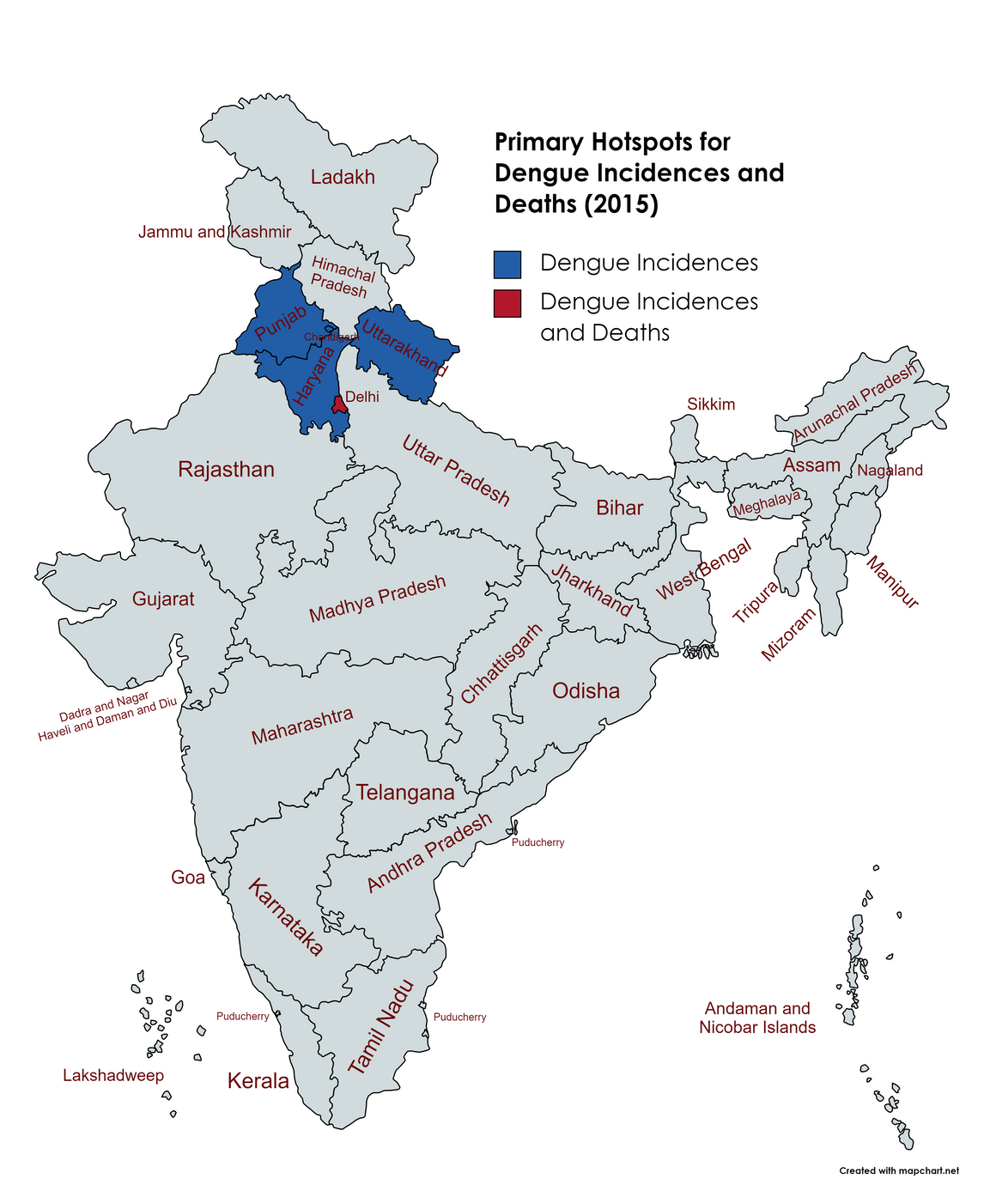
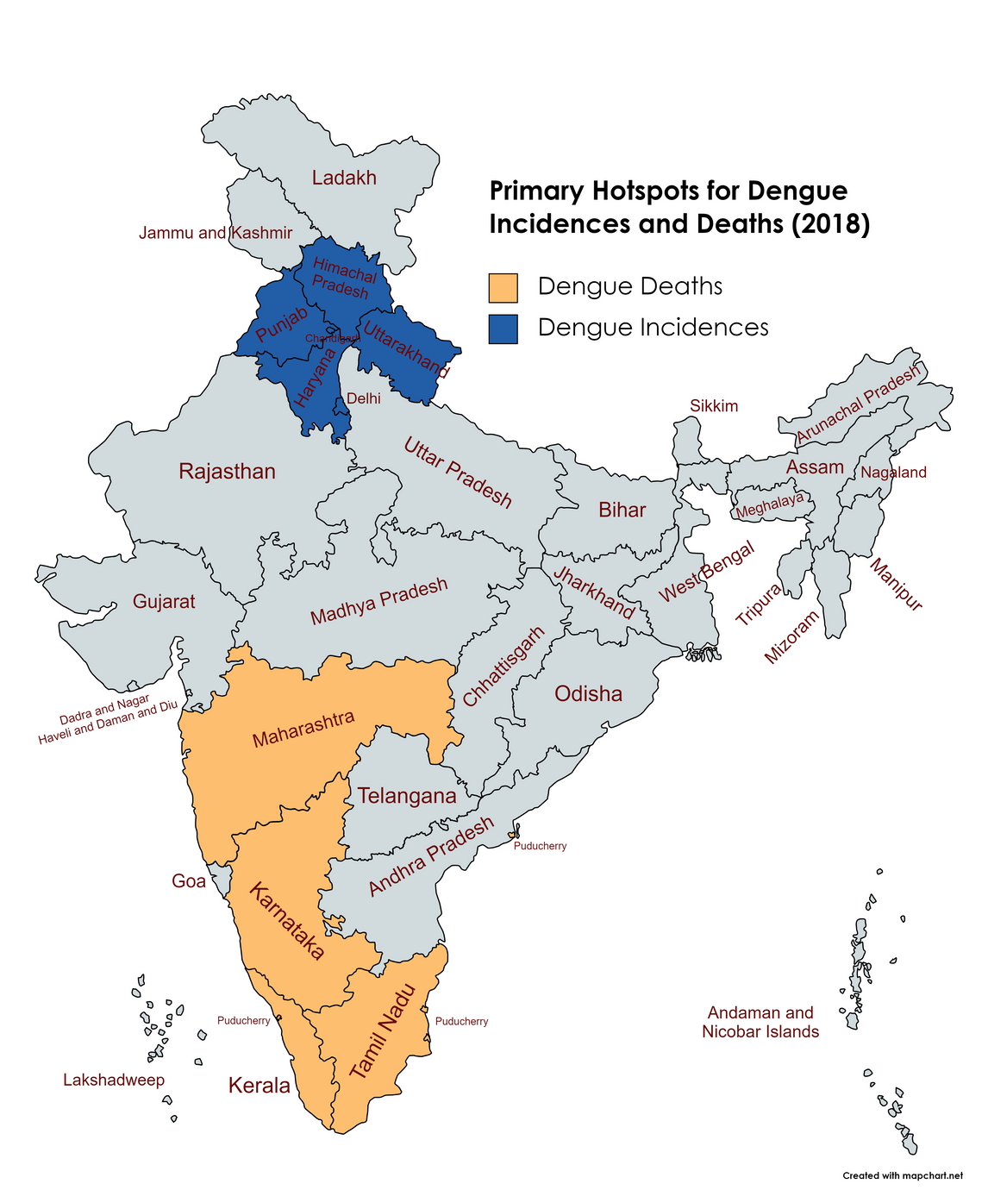
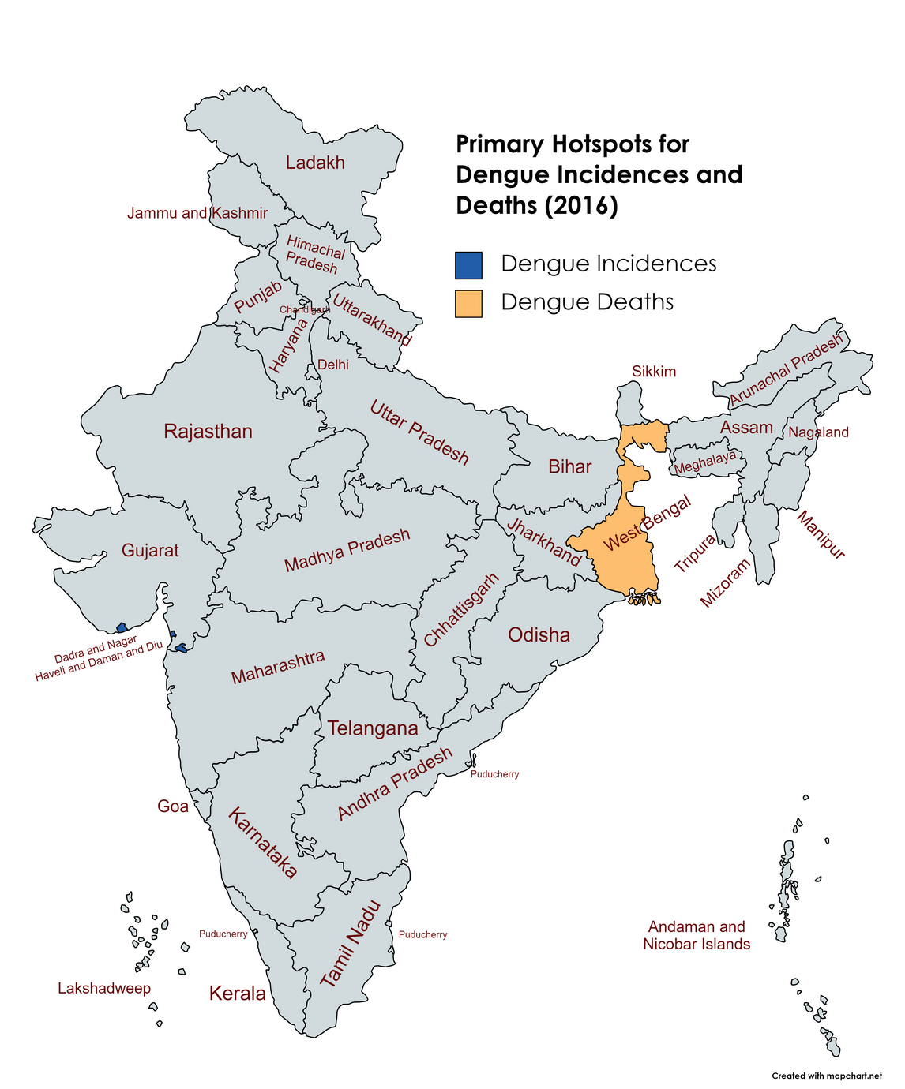
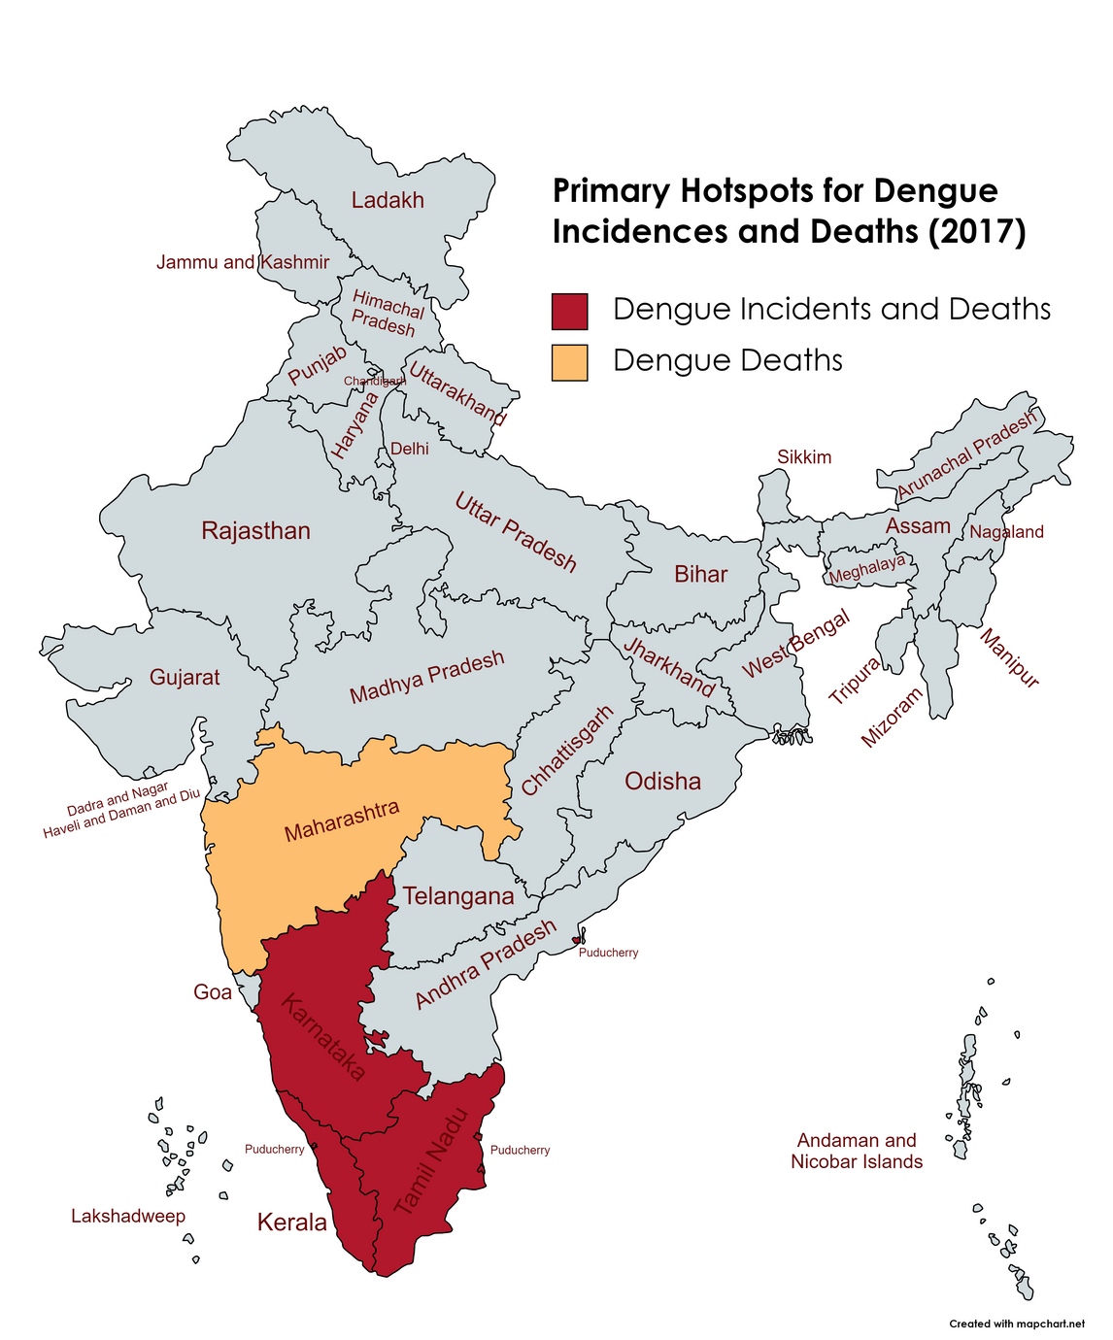
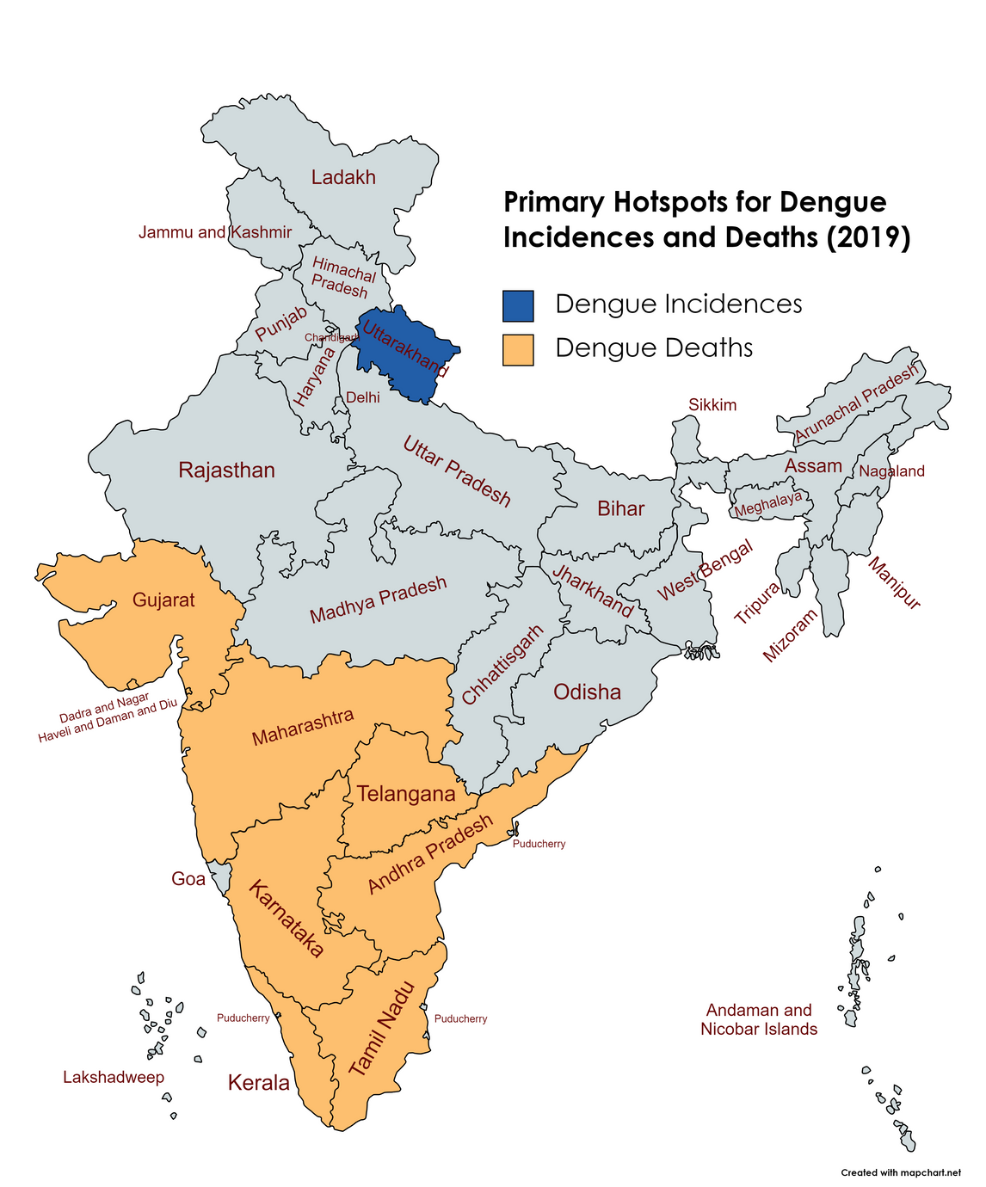
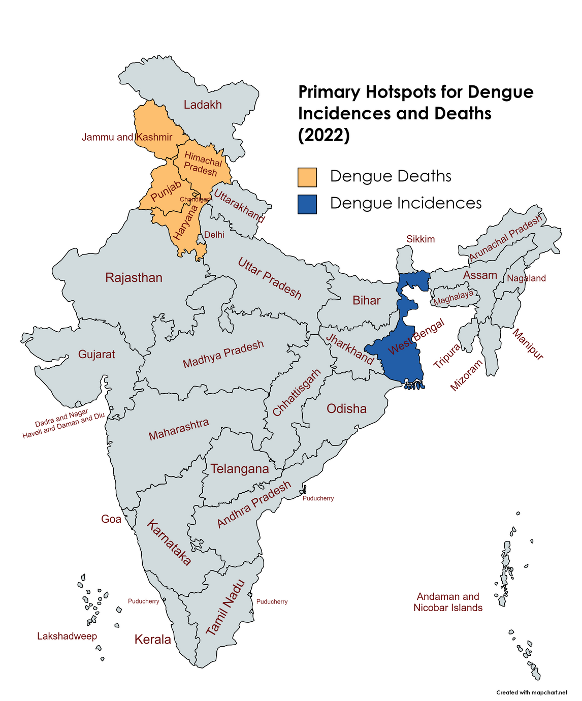
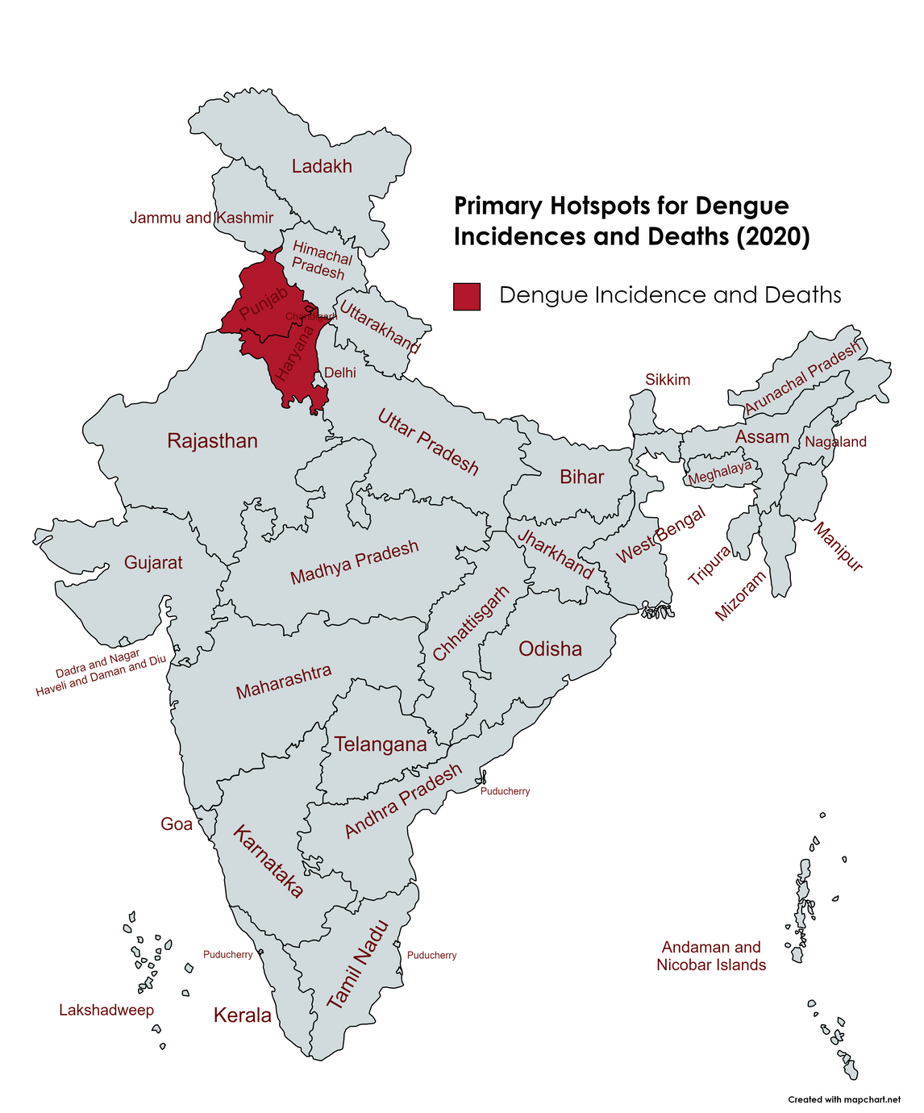
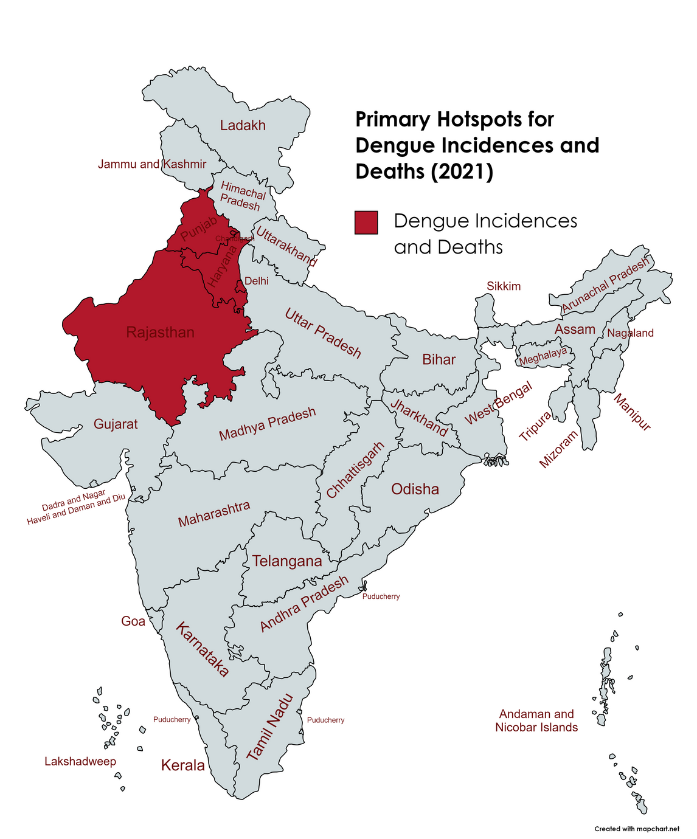

Slide 15
Interpretation & Conclusion
The descriptive analysis revealed that the dengue cases are consistent in Punjab, Andhra Pradesh, Maharashtra, Odisha, and Delhi while the dengue related deaths are consistent in Kerala, Maharashtra, Karnataka, Gujarat and Uttar Pradesh.
In Hotspot analysis, It has been noted that Maharashtra consistently has higher dengue prevalence and mortality.
Similarly over the period of 2015–2022, Chandigarh, Haryana, and Punjab are the areas with the highest dengue incidence (four years) and deaths from dengue (three years)
.

Slide 16
The consistency of a state in dengue cases and deaths over the years can be related to lack of government action or a lack of accessible health facilities for citizens.
The hotspots of dengue incidence and fatalities are a combination of both static and dynamic in nature. It might be due to the accumulation of water bodies in various places and the variation in the South-West Monsoon since the Aedes mosquito breeds in freshwater.
This analysis helps in finding the most consistent geographical areas in dengue cases and deaths which helps the officials to develop the preventive measures and control actions.

Slide 17
Thank you

